Slide 1
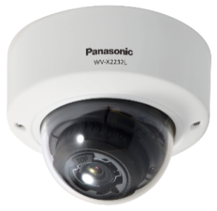
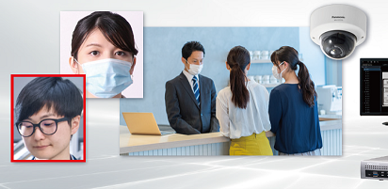
AI Non-Mask Detection Application
Material for SE
App: AI Non-Mask Detection
Document Ver.1.01
Jul. 2022

Slide 2
Contents
Product Description
Installation & Setup Guide
Concept
Key Features
Specification
Restrictions
Camera Installation Standard
Setup Procedure

Slide 3
Product Description

Slide 4
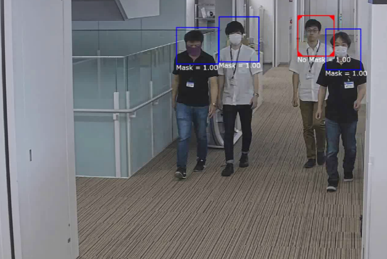
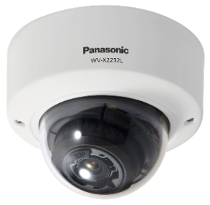



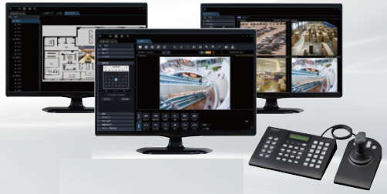





1. Concept
Non-mask detection
Automatically detect “Non-mask wearer” and issue an alarm
Key Features
System linkage
Enable linkage with various systems by utilizing a range of alarm output interfaces
*Sample image of Non-mask detection.
Model | WV-XAE203W
Product name | AI Non-Mask Detection
Supported Cameras | i-PRO with AI engine 5MP models WV-X1551LN / WV-X2251L / WV-X2551LN i-PRO with AI engine 4K models WV-X1571LN / WV-X2271L / WV-X2571LN
Support for various types of masks
Support color masks, designed masks, and various shapes of masks

Slide 5
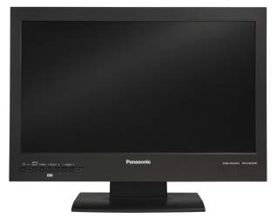
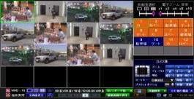


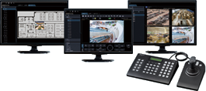


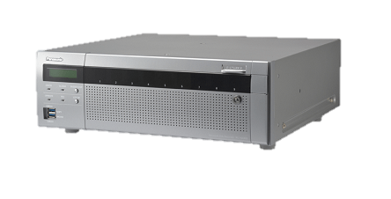

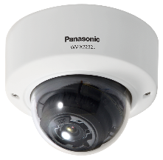
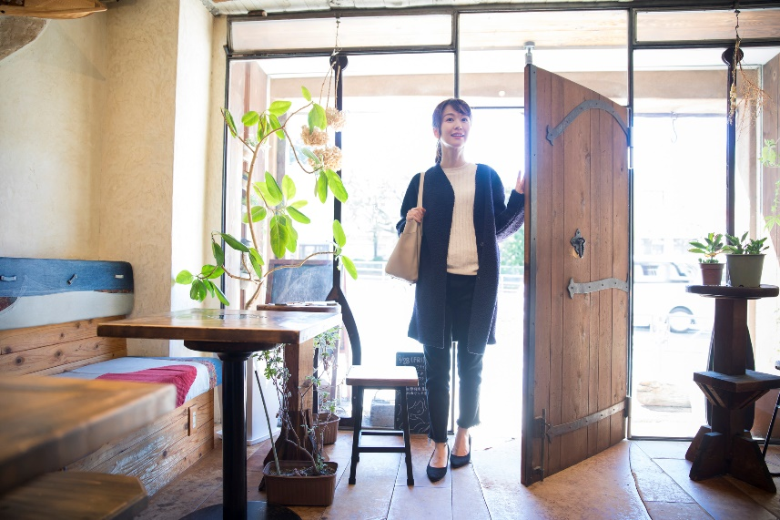
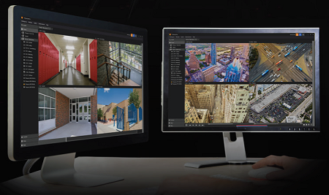
2. Key Features – System linkage
Linkage with video surveillance system
Enable linkage with other systems by utilizing various alarm output interfaces
Video data /
TCP alarm protocol notification
Video Management Software
WV-ASM300
Non-Mask Detection
Network Disk Recorder
NX Series
VIDEO INSIGHT
Video data /
Additional information on the stream

Slide 6
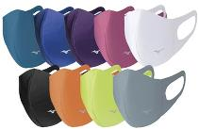
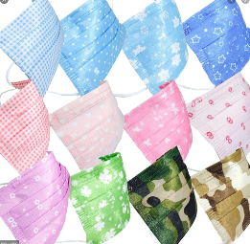

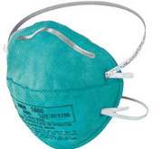


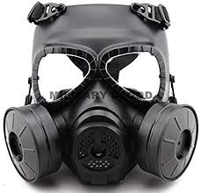

2. Key Features – Support for various types of masks
 | Color | Design | Shape
Supported
Not Supported
Example
White
Black
Gray
Light blue
Pink
Beige
Blue
Yellow
Purple
Example
Polka dot
Checkered
Tile pattern
Fashion masks
Example
Flat
Three dimensional
Pleated
N95
- Transparent
- Illustration of nose and mouth
- Full face cover
Ex. gas mask

Slide 7
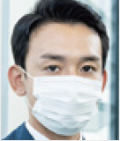
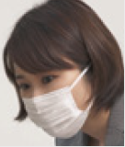
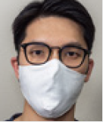
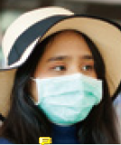
3. Specification
Detection Standard *1
Minimum detection size (Face width) | 5MP models | 60 pix
 | 4K models | 80 pix
Max. number of simultaneous detection | 8 people
Condition for alarm occurrence | Detect a non-mask wearer for two seconds or longer
Color/ Black and white | Color: supported / Black and white: NOT supported
Installation environment | Indoor / 80 lux or more
Angle of face | Right and left: within 45°, Up and down: within 30°
(*1) Note that those are theoretical values and
are not guaranteed.
Sample face images recognized as mask wearers
Facing front with a mask on
Looking sideways
(right and left: 45°, up and down: 30°)
Wearing glasses and a mask
Wearing a hat and a mask (eyebrows not covered)

Slide 8
4. Restrictions
Software specification related
This application does not work when “90°” or “270°” is selected for [Image rotation].
Performance related
This application may not detect non-mask wearers when:
- wearing a mask under the chin and the nose and mouth are not covered
- covering the mouth with a hand and so on
- outline of the mouth is covered with beard
This application may detect the followings as non-mask wearers:
- dolls, human in a poster, and so on
Other
As for the restrictions when installing multiple extension software applications on a camera, refer to the support information “Compatibility list for extension software <C0103>” at the link below.
https://i-pro.com/global/en/surveillance/training-support/support/technical-information

Slide 9
Installation & Setup Guide

Slide 10


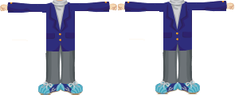
1. Camera Installation Standard – Install on the ceiling
Recommended cameras
Product name | i-PRO with AI engine 5MP models
Model | WV-X1551LN / WV-X2251L / WV-X2551LN
Note: i-PRO with AI engine 4K models are not recommended as they do not satisfy the recommended detection size (120 pix or more) and angle of depression at the same time.
*See page 25
Recommended installation environment
1) Face width(a) ≥ 80 pix
2) 5°≤ Angle of depression(θ) ≤ 15°
θ
a
θ
6.4m (21ft)
We recommend the location where subjects walk straight toward the camera, facing front.
Face width(a) can be set to approx. 80 pix when adjusting the width of camera view to 4 people opening the arms.
Adjust the angle of depression from 5°to 15°to capture the front face.

Slide 11
1. Camera Installation Standard – Install on the ceiling
Reference: Distance between camera and subject
Recommended area for camera installation
5m
(16.4ft)
7m
(23ft)
9m
(29.5ft)
11m
(36.1ft)
13m
(42.7ft)
15m
(49.2ft)
Distance from face detection start point (S)
3.0m
(9.8ft)
1.6m (5.3ft)
Face width at start point (S) |  |  |  |  | 121pix |  | 95pix |  | 78pix |  | 66pix |  | 57pix
Angle of depression at end point (E) |  |  |  |  | 17.3° |  | 12.2° |  | 9.4° |  | 7.6° |  | 6.4°
Face detection start point (S)
Face detection area
End point (E)
Conditions
Product name | i-PRO with AI engine 5MP model
Model | WV-X1551LN / WV-X2251L / WV-X2551LN
Mounting height | 3.0m (9.8ft)
Zoom ratio | x3.1 *Maximum optical zoom ratio
Required face detection area is approx. 2.5m (8.2ft) or more.
= Walking speed (approx. 1.2m (3.9ft)/s) x Travel time (2s)

Slide 12
2. Setup Procedure – Flowchart
The following flowchart describes required settings for the linkage with video surveillance system.
Preparation
Install the extension software “WV-XAE203W” on the camera.
*For details, refer to the instruction manuals of WV-XAE203W
https://i-pro.com/global/en/surveillance/training-support/documentation-database-list
Camera settings
Configure schedule and TCP alarm protocol notification.
Recorder settings
Configure extension software alarm, camera site alarm, schedule, recording setup, and TCP alarm protocol notification.
ASM300 settings
Configure extension software alarm and TCP alarm protocol reception.

Slide 13
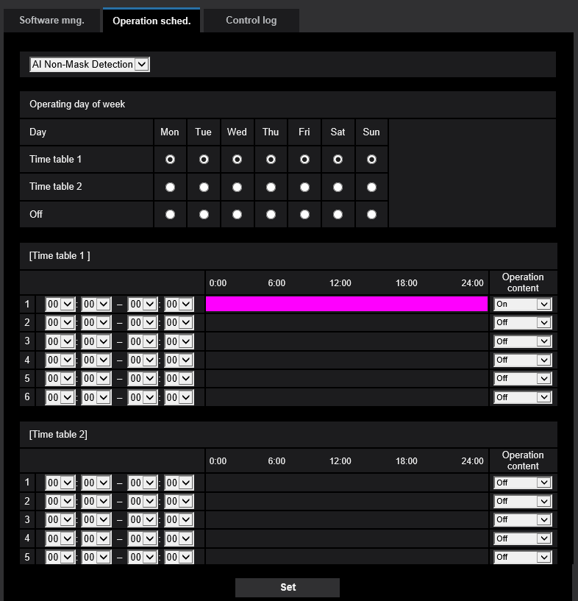
2. Setup Procedure – Camera settings
Configure schedule and TCP alarm protocol notification.
*As for TCP alarm protocol notification setting, refer to the “Appendix” chapter described later.
Schedule setting
*Default setting = 24-hour operation
Extension software
Select “AI Non-Mask Detection”.
Operating day of week
Select the day of week to activate AI Non-Mask Detection for “Time table 1” and “Time table 2”.
AI Non-Mask Detection does not operate on the day of week with “Off” selected.
Time table
Set the time to activate AI Non-Mask Detection, and operation content(On/Off). Up to 6 operating times can be set respectively for [Time table 1] and [Time table 2].

Slide 14
2. Setup Procedure – Recorder settings
Configure extension software alarm, camera site alarm, schedule, recording setup, and TCP alarm protocol notification. *As for the settings other than extension software alarm, refer to the “Appendix” chapter described later.
Extension software alarm setting
Extension software alarm
Go to [REC & event]-> [Advanced setup] tab -> [Extension software alarm], and click “Setup” to open the [Extension software alarm] setup screen.
Set AI Non-Mask Detection alarm in an available line from No.5 to 8.
No.
No.1-4: reserved for AI-VMD
No.5-8: available
Name
Enter the name of alarm.
Ex. “AI Non-Mask Detection”
Message ID
Enter “69” as an ID for AI Non-Mask Detection alarm.

Slide 15
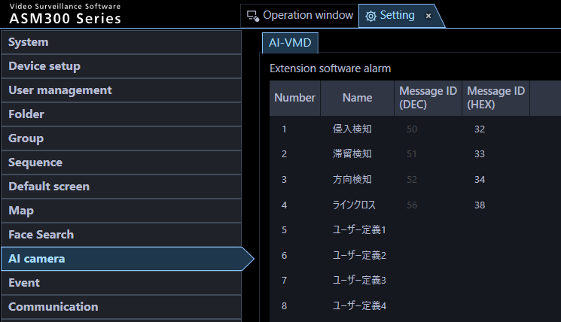

2. Setup Procedure – ASM300 settings
Configure extension software alarm and TCP alarm protocol reception.
*As for TCP alarm protocol notification setting, refer to the “Appendix” chapter described later.
Extension software alarm setting
Set AI Non-Mask Detection alarm in an available line from No.5 to 8.
No.
No.1-4: reserved for AI-VMD
No.5-8: available
Intruder
Loitering
Name
Enter the name of alarm.
Ex. “AI Non-Mask Detection”
Direction
Cross Line
User-defined 1
Message ID
Enter “69” as an ID for AI Non-Mask Detection alarm.
User-defined 2
User-defined 3
User-defined 4

Slide 16
Appendix

Slide 17
Alarm Linkage Setting

Slide 18
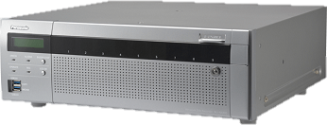
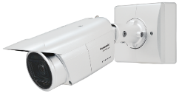
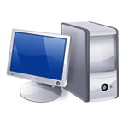
Setup Flow
Camera Settings
To perform event recording on the recorder or pop-up alarm notification on WV-ASM300 triggered by AI-VMD, configure the alarm linkage in the following order: 1. Camera, 2. NX series recorder and 3. WV-ASM300.
(1)
TCP alarm
Recorder Settings
System Configuration (Ex.)
Site alarm
Extension
software
Recorder
Camera
NX series
(2)
Schedule
(2)
WV-XAE203W
WV-X1551LN
.ext
192.168.0.250
Recording
Alarm notification
192.168.0.21
Monitoring software
TCP alarm
(1)
ASM300
(3)
ASM300 Settings
(3)
192.168.0.200
Alarm reception

Slide 19
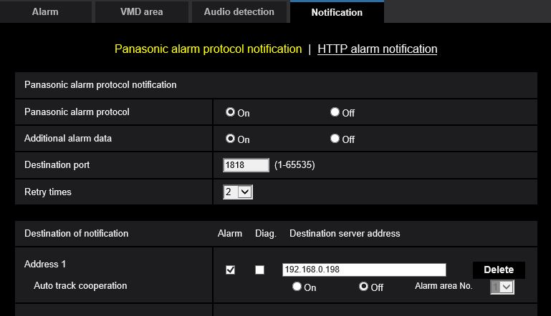
Camera Settings – TCP alarm protocol notification
Setup > Alarm > Notification > TCP alarm protocol notification
Camera Settings
TCP alarm
Recorder Settings
Set [TCP alarm protocol] to “On”
Site alarm
Set [Additional alarm data] to “On”
Schedule
Recording
Tick “Alarm” and input IP address of NVR
TCP alarm
192.168.0.250
ASM300 Settings
Alarm reception

Slide 20
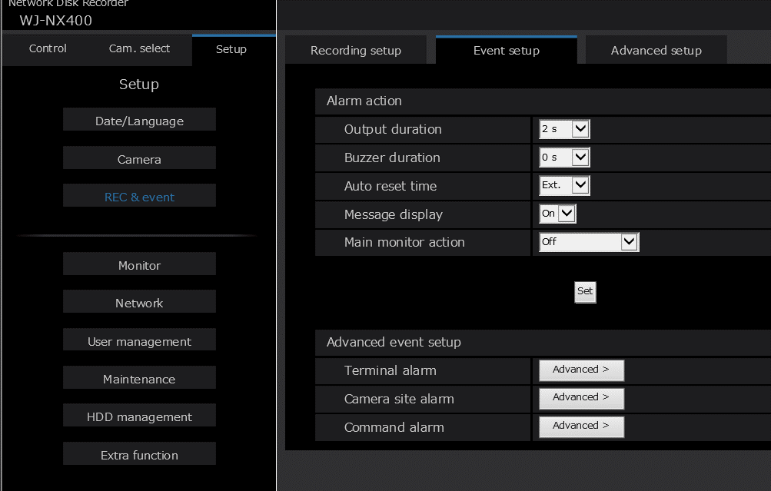
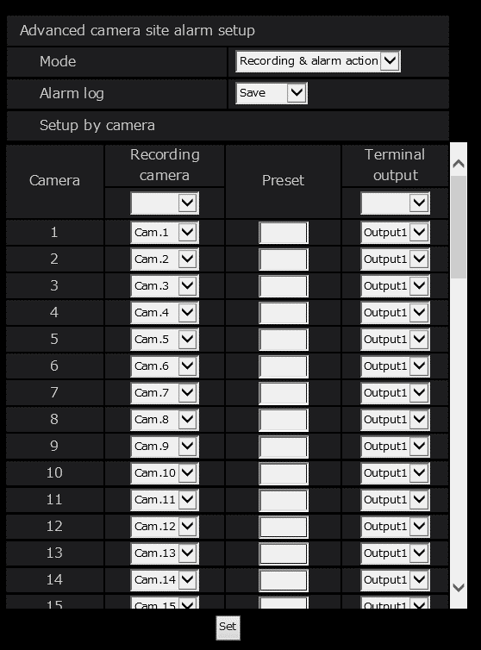
Recorder Settings – Camera site alarm
Setup > REC & event > Event setup > Camera site alarm
Camera Settings
TCP alarm
Set the [Mode] option to “Recording & alarm action”
Recorder Settings
Site alarm
Schedule
Recording
TCP alarm
ASM300 Settings
Alarm reception

Slide 21
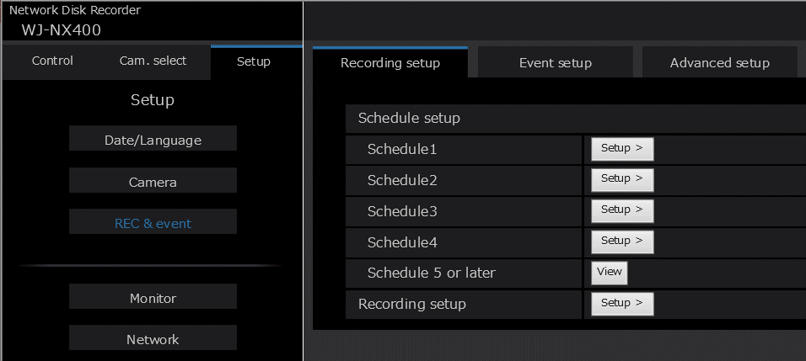
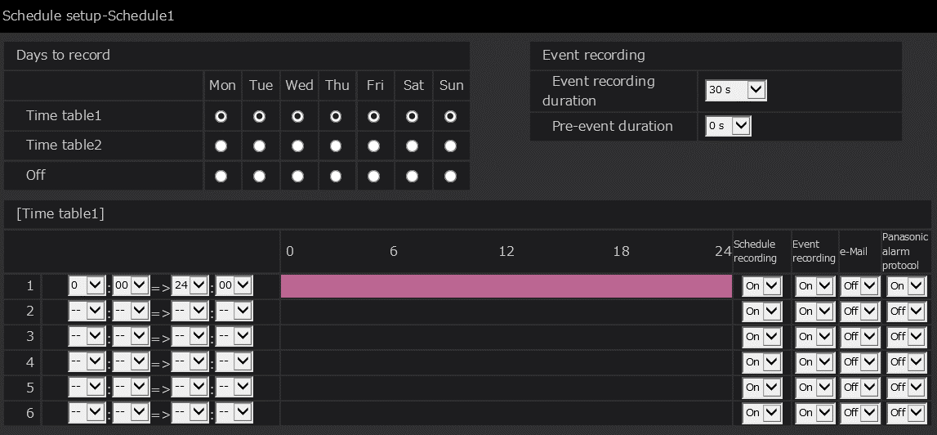
Recorder Settings – Schedule
Setup > REC & event > Recording setup > Schedule
Camera Settings
TCP alarm
Recorder Settings
Site alarm
Schedule
Set [TCP alarm protocol] to “On”
Recording
TCP alarm
ASM300 Settings
Set [Event recording] to “On”
Alarm reception

Slide 22
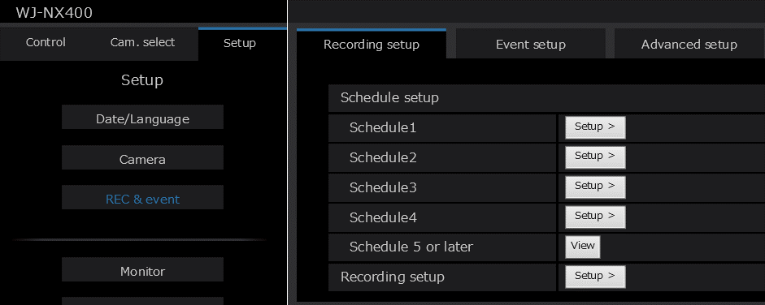
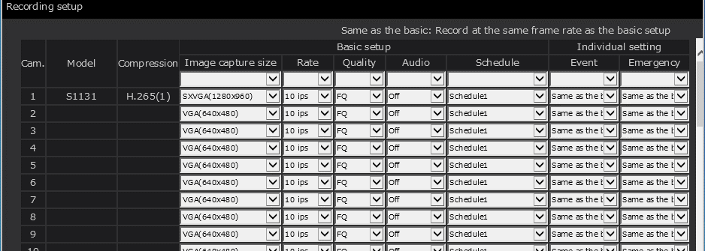
Recorder Settings – Recording setup
Setup > REC & event > Recording setup
Camera Settings
TCP alarm
Recorder Settings
Site alarm
Schedule
Recording
TCP alarm
Set proper schedule to target cameras
ASM300 Settings
Alarm reception

Slide 23
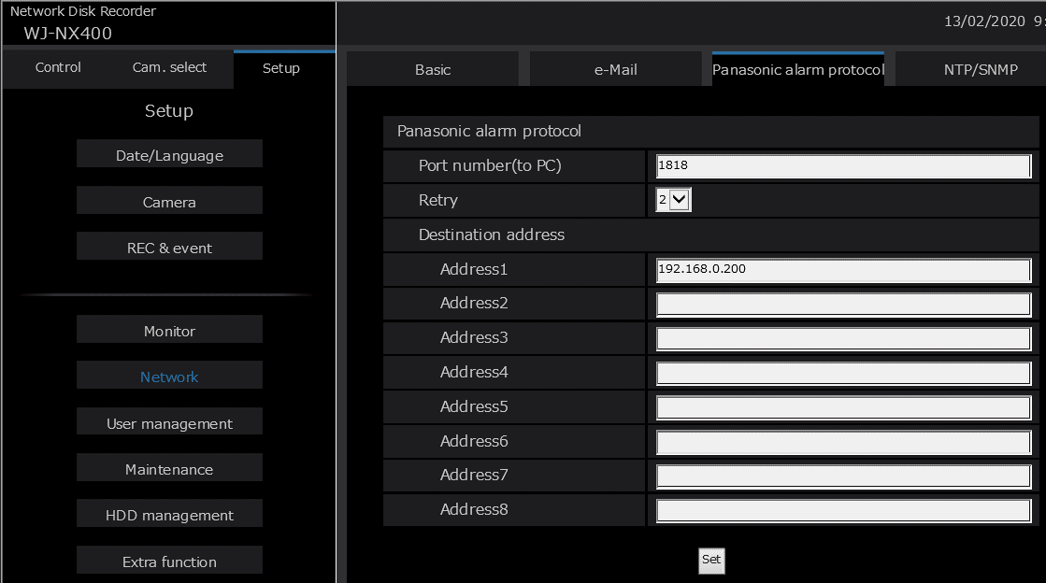
Recorder Settings – TCP alarm protocol
Setup > Network > TCP alarm protocol
Camera Settings
TCP alarm
Recorder Settings
Site alarm
Schedule
Type ASM300 IP Address here.
This is Alarm destination.
Recording
TCP alarm
ASM300 Settings
Alarm reception

Slide 24
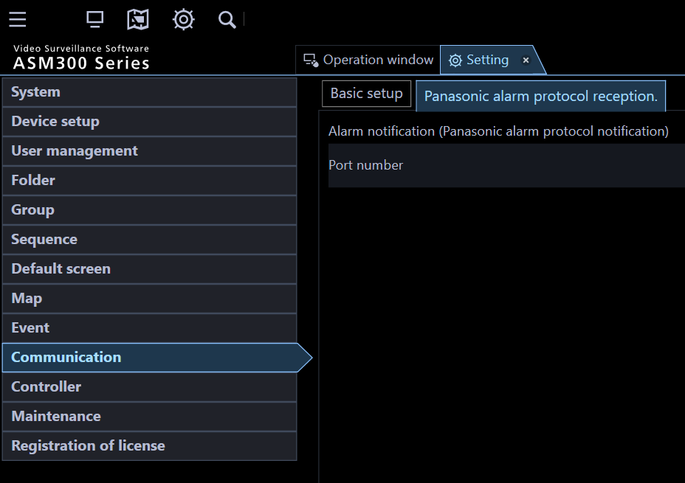
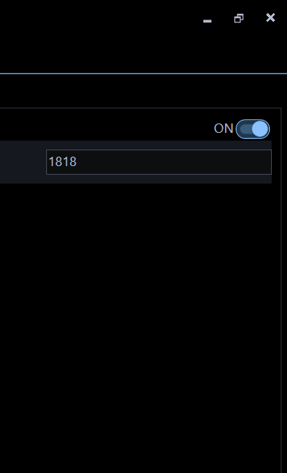
ASM300 Settings – TCP alarm protocol reception
Setting > Communication > TCP alarm protocol reception
Camera Settings
TCP alarm
Recorder Settings
Site alarm
Set [Alarm notification (TCP alarm protocol notification)} to “ON”
Schedule
Recording
TCP alarm
ASM300 Settings
Alarm reception

Slide 25
Distance between Camera and Subject [4K models]

Slide 26
Distance between Camera and Subject [4K models]
Note: i-PRO with AI engine 4K models are not recommended as they do not satisfy the recommended detection size (120 pix or more) and tilt angle at the same time.
5m
(16.4ft)
7m
(23ft)
9m
(29.5ft)
11m
(36.1ft)
13m
(42.7ft)
15m
(49.2ft)
Distance from face detection start point (S)
3.0m
(9.8ft)
1.6m (5.3ft)
Face width at start point (S) |  |  |  |  | 108pix |  | 85pix |  | 69pix |  | 59pix |  | 51pix
Angle of depression at end point (E) |  |  |  |  | 17.3° |  | 12.2° |  | 9.4° |  | 7.6° |  | 6.4°
Face detection start point (S)
Face detection area
End point (E)
Conditions
Product name | i-PRO with AI engine 4K model
Model | WV-X1571LN / WV-X2271L / WV-X2571LN
Mounting height | 3.0m (9.8ft)
Zoom ratio | x2 *Maximum optical zoom ratio
Required face detection area is approx. 2.5m (8.2ft) or more.
= Walking speed (approx. 1.2m (3.9ft)/s) x Travel time (2s)

Slide 27
Evaluation Results

Slide 28
Evaluation Results from Each Environment
Location (i-PRO office) | Time of day | Illuminance | Number of cases |  | True positive | False positive | False negative
 |  |  | Mask wearer | Non-mask wearer
Bldg. E, 1st floor | 10:00am - 9:00pm | 100 lux - 150 lux | 300 | 90 | 91.1% (81/90) | 0.3% (1/300) | 8.9% (9/90)
Bldg. E, 6th floor | 10:00am - 9:00pm | 80 lux - 500 lux | 30 | 16 | 100% (16/16) | 3.3% (1/30) | 0% (0/16)
Room# E312 | 5:00pm - 8:00pm | 80 lux - 240 lux | 33 | - | - | 0% (0/33) | -
Bldg. P, 1st floor | 8:00am - 10:00am | 500 lux - 700 lux | - | 56 | 92.9% (52/56) | - | 7.1% (4/56)
Bldg. P, 3rd floor | 11:00am - 3:00pm | 400 lux - 500 lux | 3 | 6 | 100% (6/6) | 0% (0/3) | 0% (0/6)
Total |  |  | 366 | 168 | 92.2% (155/168) | 0.5% (2/366) | 7.7% (13/168)
True positive rate: Cases correctly detected as non-mask wearers / The number of non-mask wearers
False positive rate: Cases incorrectly detected as non-mask wearers / The number of mask wearers
False negative: Cases of missed alarm / The number of non-mask wearers

Slide 29
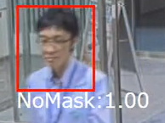
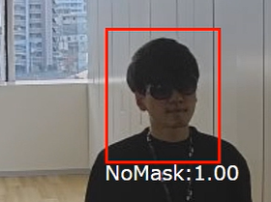
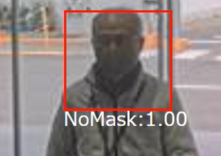
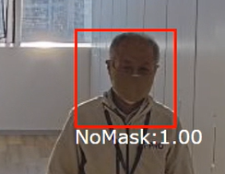
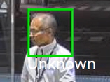
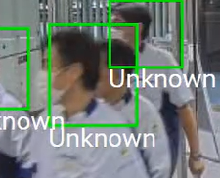
Sample Evaluation Results
 | Building E, 1st floor | Building E, 6th floor
 |  | -
True Positive Example
False Positive Example
Wearing a beige mask under backlight condition
Wearing a beige mask under backlight condition
False Negative Example
Looking sideways
People overlapped

Slide 30
Version History

Slide 31
Version History
No | Update contents | Page No. | Version | Update
1 | 1st Version | - | 1.00 | 17.Dec.2020
2 | Support company name change | - | 1.01 | 14. Jul. 2022
3
4
5
6
7
8
9
10

